Slide 2
In Partnership with America’s Newspapers
Recommended Media Kit

Slide 3
Insert Your Logo
Insert Pictures of Your Publications
MEDIA KIT
LOCAL | ENGAGED | TRUSTED

Slide 4
BRAND STORY
Insert Pictures of Your Story Telling
The XXXX Media is a multi-platformed news and information company that reaches its diverse audience via newspaper, magazines, niche publications, digital media and local events. The XXXX Media provides advertisers with specialized campaigns, leveraging multiple marketing and advertising tactics to reach a targeted audience.
Advertisers can be confident that well planned, well executed advertising campaigns will deliver a high return on investment. The XXXX Media has an array of daily, weekly, monthly and quarterly publications, websites, social media, and email newsletters that bring news and information to the community.

Slide 5
REACH AND DISTRIBUTION
THE XXXX Media
Insert Distribution Map Here

Slide 6
THE XXXX Media
REACH AND DISTRIBUTION
PRINT CIRCULATION
DIGITAL
Insert Audience Stats Here
16,500 DAILY
28,400
SUNDAY
18,800 BIZNET
1.8 MILLION MONTHLY PAGEVIEWS
180,000 MONTHLY UNIQUE VISITORS
OVER 6 MINUTES ONSITE PER USER SESSION
SUNDAY
35% MOBILE
65% DESKTOP + TABLET
Includes the circulation of the XXXX Media,

Slide 7
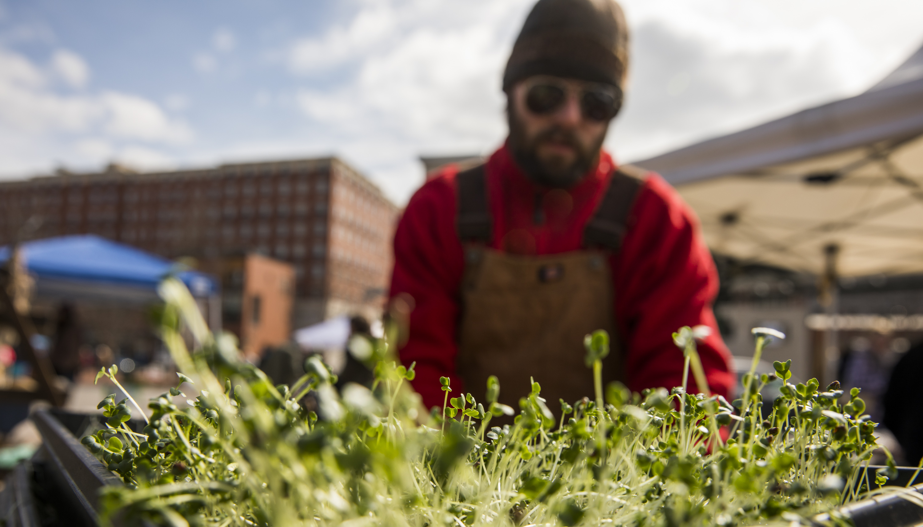
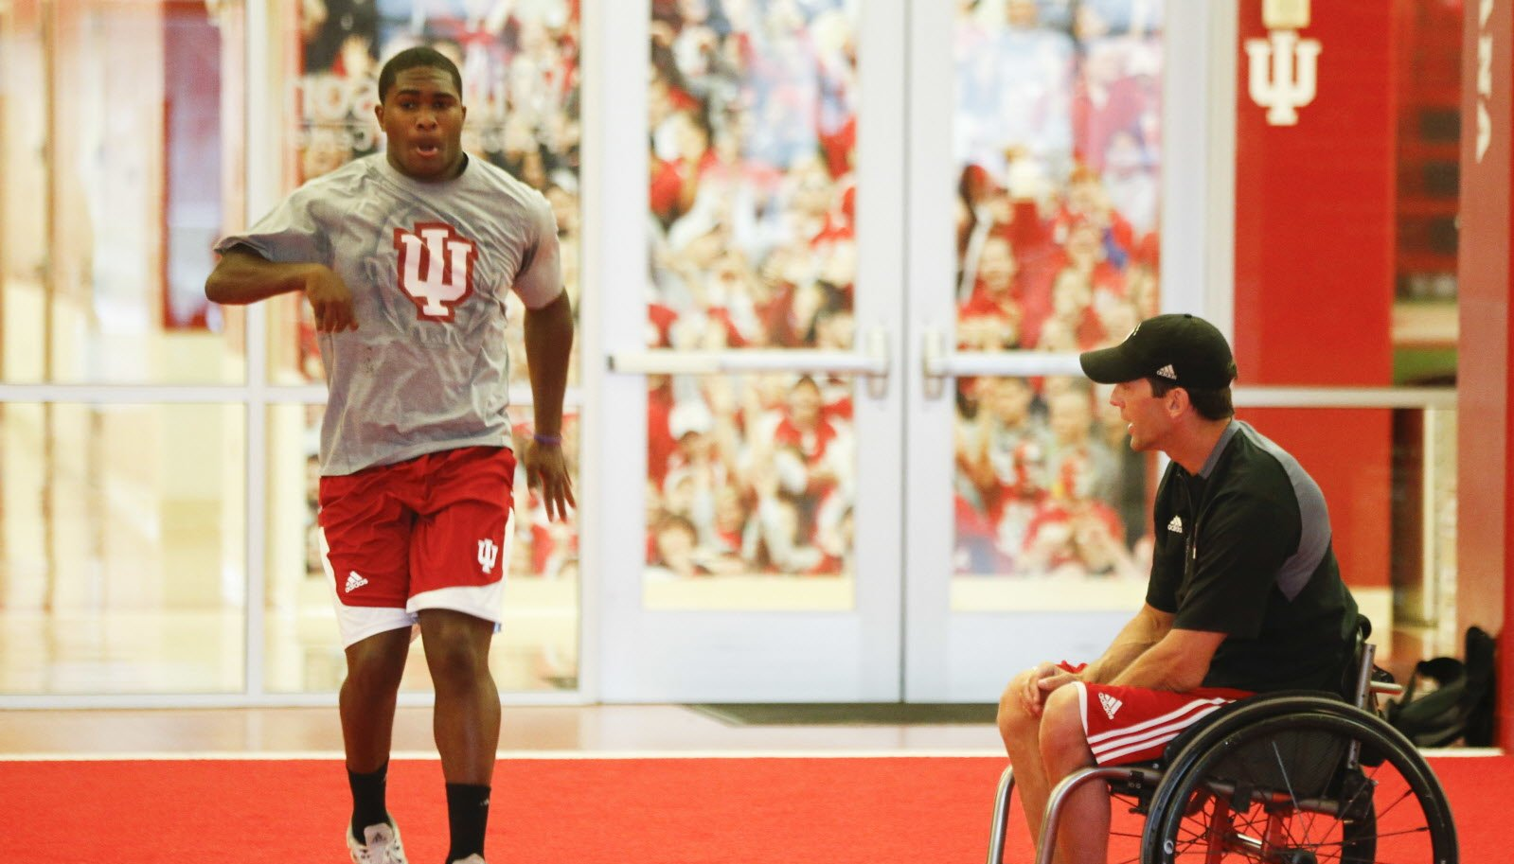
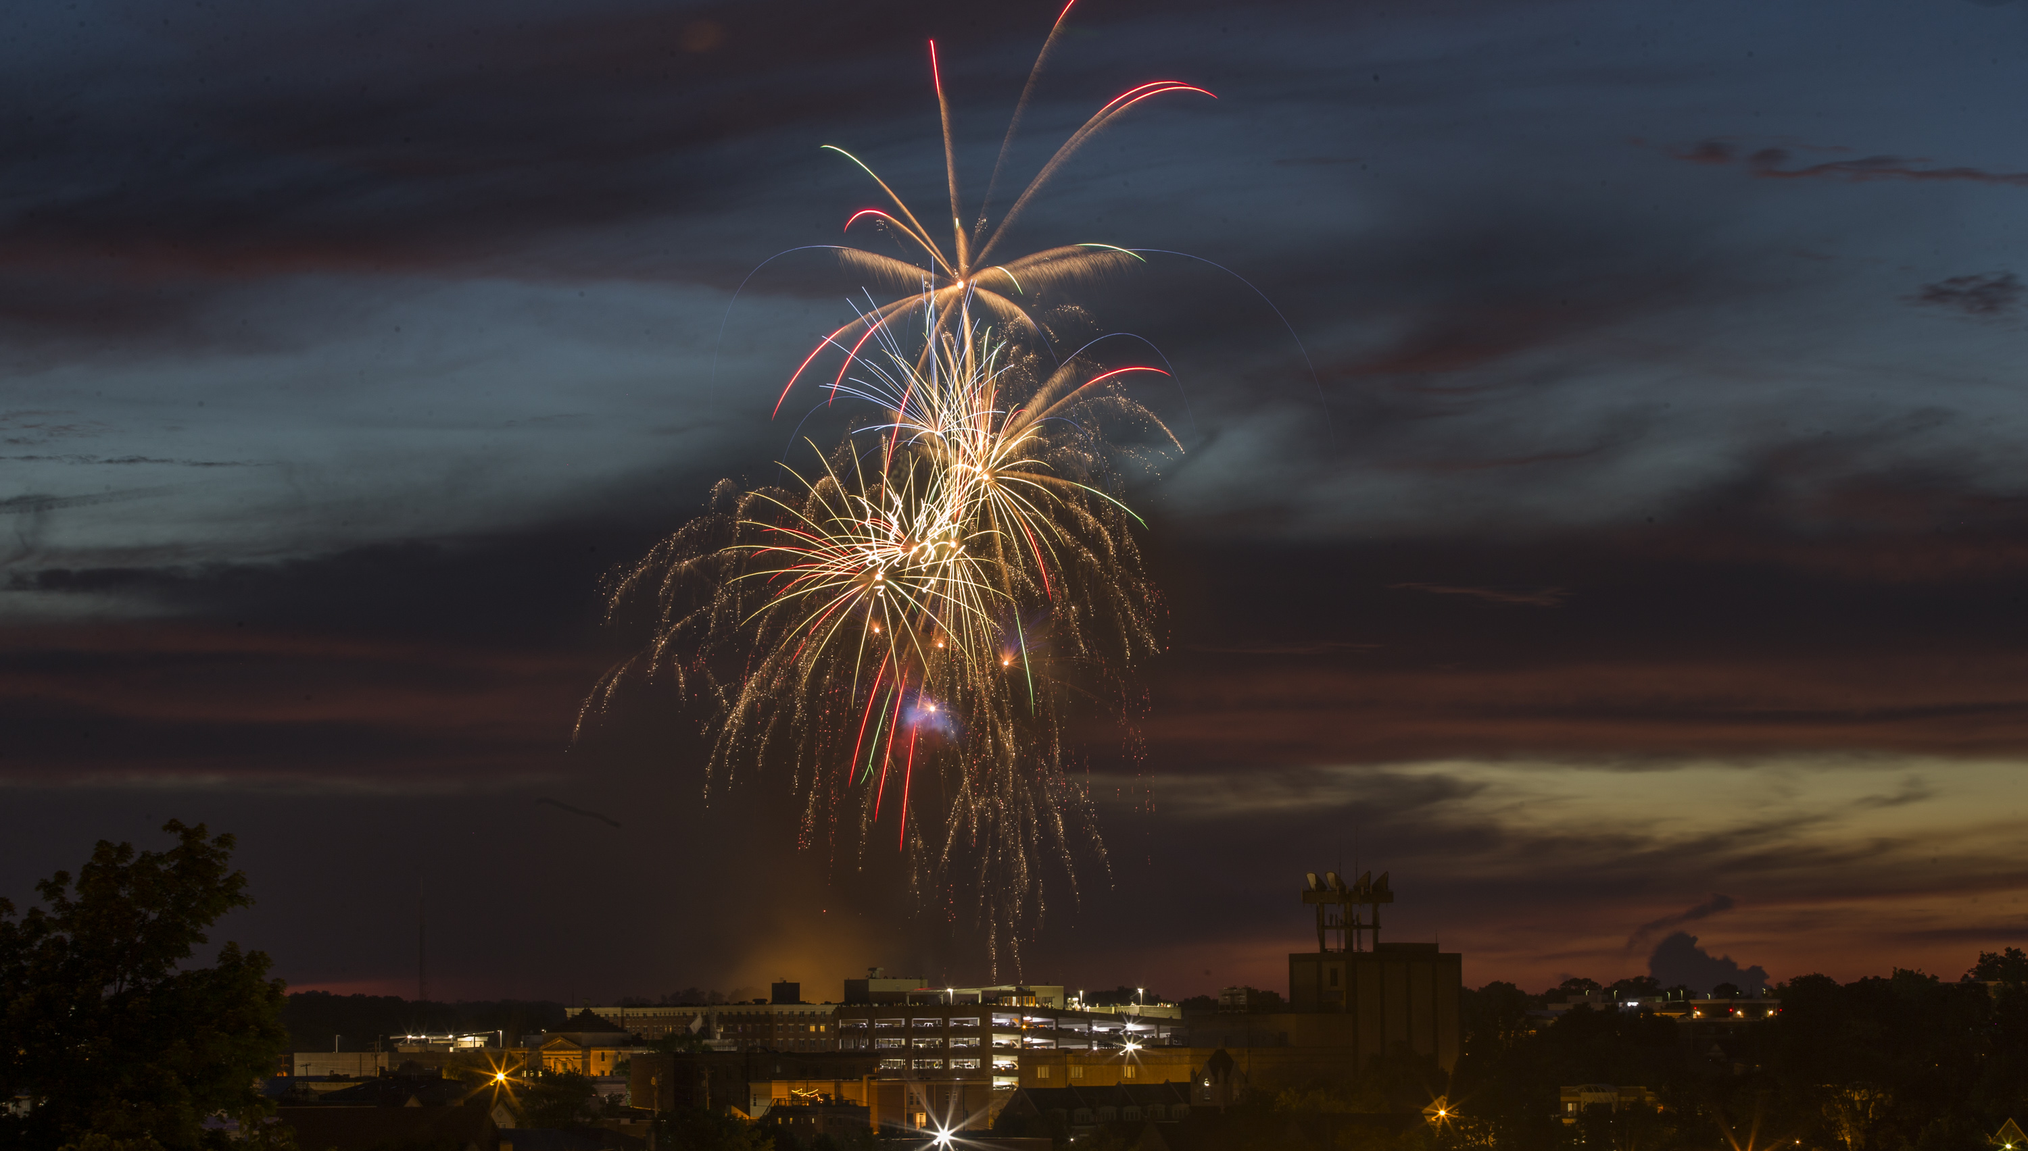
THE XXXX Media
THE FACTS
LOCAL
ENGAGED
TRUSTED
Founded by XXXXX in 1877, The XXXX Media has had long-standing relationships with both our readers and advertisers. Our team lives and works in this community, giving us the unique perspective and insight your business needs to succeed. Our advertising team is known for well planned, well executed advertising campaigns that deliver a high return on investment.
The XXXX Media audiences are comprised of highly educated, mid-to-high-income residents, predominantly families with children. Our publications boast the largest reach in the XXX DMA
Award winning journalism for the Bloomington community.
In 2019, The XXXX Media won 13 awards — 10 of them first place — from the Society of Professional Journalists.
In 2018, The XXXX Media journalist were awarded 10 awards honors, including four first-place awards and first place Best Digital Presence, XXXXX

Slide 8
THE XXXX Media
TARGETED DEMOGRAPHICS
DIGITAL VISITORS
DIGITAL VISITORS (CONT.)
Online readers are engaged, liked to be kept up-to-date on local events and return to the website several times a day.
72% of visitors are returning visitors
53% of visitors are between 35-64 years old
39% of visitors are between 35-54 years old
65% of visitor are college graduates or advanced degree holders
1.8 MILLION MONTHLY WEBSITE PAGEVIEWS
230,000 MONTHLY UNIQUE VISITORS
Insert Audience Stats Here
55%
MALE
45%
FEMALE
AGE: <24
PRINT READERS
24%
8%
AGE:65+
XXXX Media Print Readers are loyal, educated, have more disposable income and are engaged in the community.
70% of consumers visit stores after seeing newspaper ads
63% of XXXX access a printed newspaper each week.
Reach 80% of 35-54 years old
Educated, employed and integrated into the community; leaders
15%
14%
AGE: 55-64
AGE: 25-34
AGE: 35-44
20%
19%
AGE: 45-54

Slide 9
THE XXXX Media
REACH
SOCIAL AUDIENCES
ANNUAL PUBLICATIONS
Add in Niche Pubs, Audiences, Social Stats, and programmatic, eblast, etc.
19,000 THE XXXX Media
25,400 THE XXXX Media
WEDDING GUIDE
Publication in partnership with the annual bridal expo
BASCI HOME SHOW
Program for the annual home show improvement showcase
3,100 THE HOOSIER SCOOP
8,400 MIKE MILLER (IU SPORTS)
NICHE AUDIENCES
SENIOR GUIDES
Spring and fall content regarding the abundance of local senior care options
FAMILY GUIDE
A robust preview of camps, classes and activities for families and kids
BIZNET Published in conjunction with the Chamber of Commerce reaching community business leaders
SIP & SAVOR Monthly look at the vibrant craft beer, spirits and local food scene
INSTRIDE Focus on active Boomers and their lifestyle options and choices
DIGITAL AUDIENCE EXTENSION

Slide 10
THE XXXX Media
”
TESTIMONIALS
We appreciate how well our community newspaper reaches our audience. We choose to advertise in The XXXX Media to boost attendance, reach volunteers and grow our event!
Craig Brenner, Boogies -Blues & Boogie Woogie Piano Festival
”
”
Advertising with the HT has almost doubled the number of patients who are taking advantage of our ability to make crowns in a single visit. They are pleased with our technology that allows us to save them the hassle of a temporary crown and a return visit. It’s great that the XXX is helping Baker Family Dentistry put smiles on patient’s faces! Thanks!
Dr. Lisa Baker, XXXXX Family Dentistry
As a small business I wear all the hats. Accounts payable, accounts receivable, ordering supplies, keeping personnel records etc. I give you little to work with as we don't have an advertising department. It needs to hit certain marks so we can co-op the cost with XXXX and you get it done.
Mary Ann Jacobs, J&S Locksmith
”
We offered XXX Readers our award-winning fries for free to people who used a super-secret code word. Over 250 customers participated! We did more business just at lunch that one day than we did the entire day (breakfast, lunch, & dinner) the week before.
Samantha Aulick. Artisan Foodworks

